Slide 1


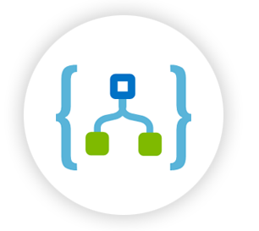

Serverless Computing

Slide 2
Serverless Computing
Azure Functions
Logic Apps
Notes:
Serverless Compute Serverless Events

Slide 3
Evolution of Serverless Computing

Slide 4
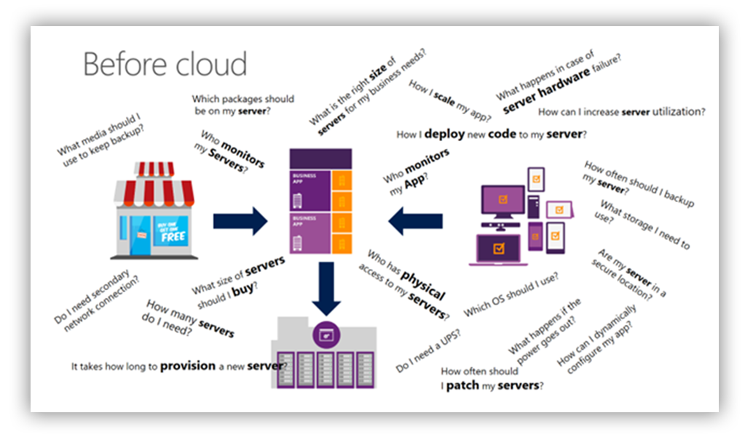

Slide 5
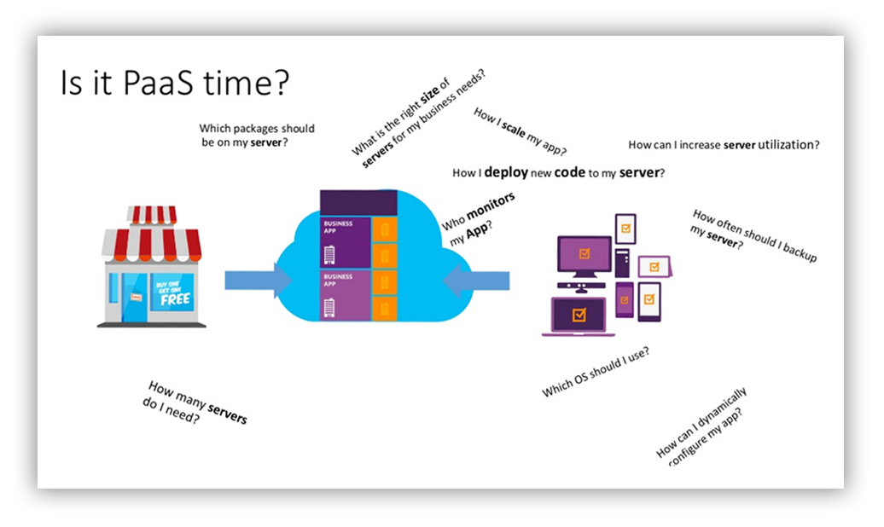

Slide 6
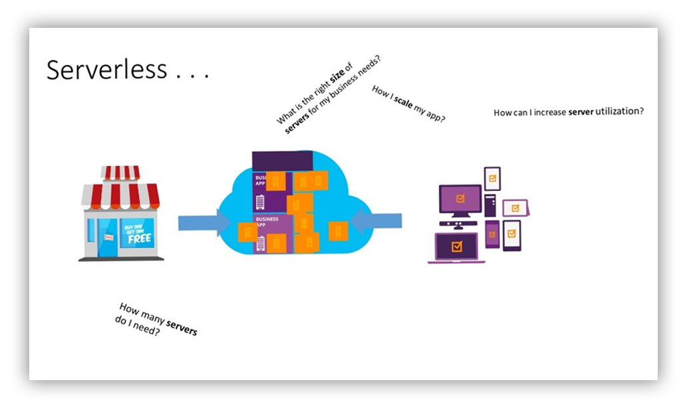

Slide 7
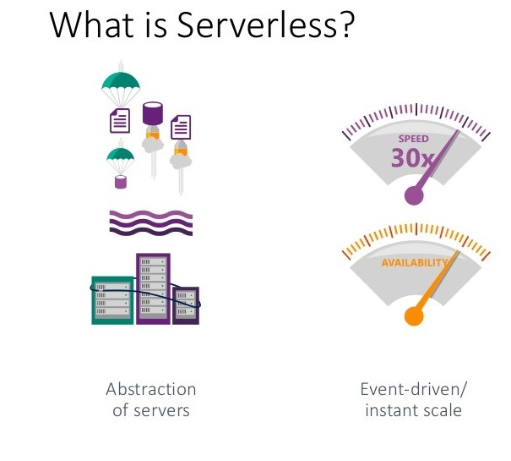
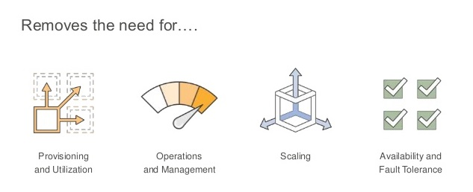

Slide 8
Serverless Computing (FaaS)

Slide 9
Serverless Computing (FaaS)
Similar Technologies
AWS Lambda
Google Cloud Functions
Open Whisk (IBM)
Function as a Service (Azure Functions)
Platform to develop, run, and manage application
Without the complexity of building and maintaining the infrastructure

Slide 10
Introducing Azure Functions
Azure Functions
Make composing Cloud Apps insanely easy
Develop Functions in C#, JavaScript, F#, Python, PHP, Batch, Typescript
Easily schedule event-driven tasks across services
Expose Functions as HTTP API endpoints
Scale Functions based on customer demand
Easily integrate with Logic Apps

Slide 11
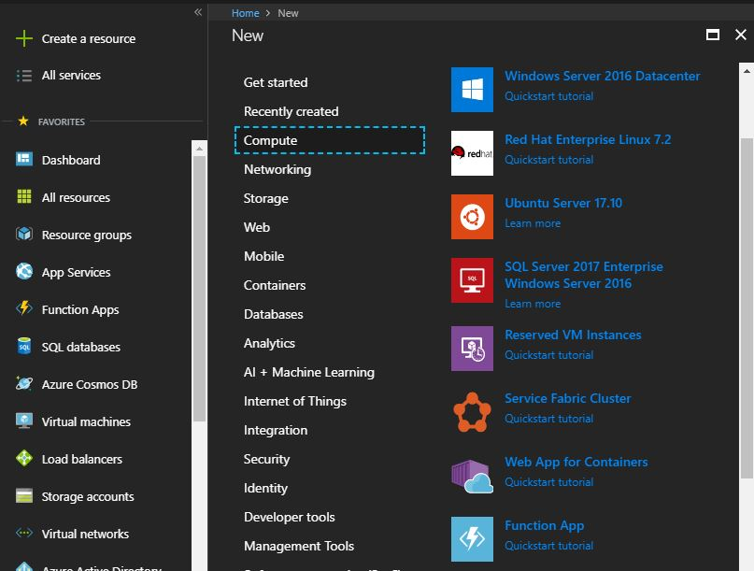
Create Function Portal

Slide 12
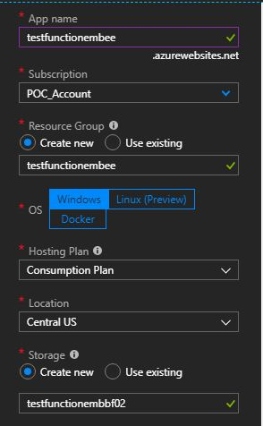
Create Function Portal

Slide 13
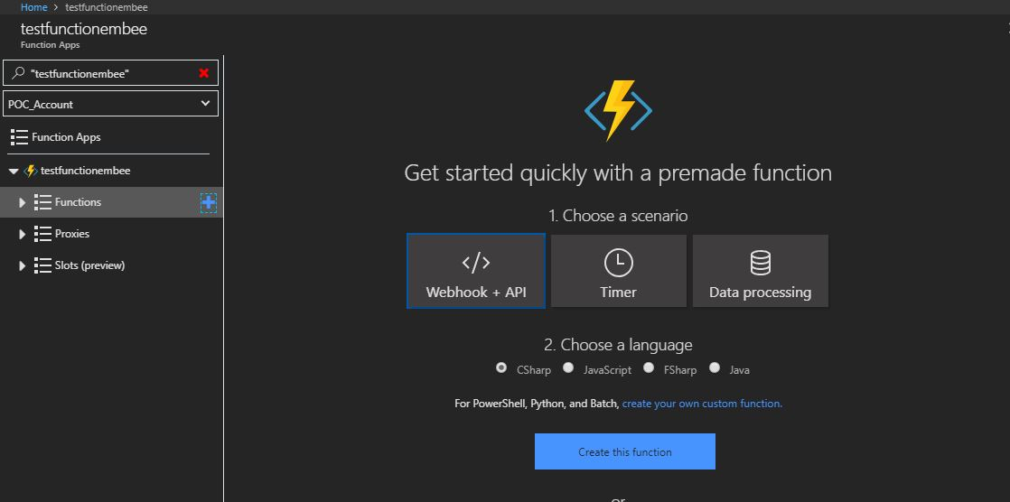
Create Function Portal

Slide 14
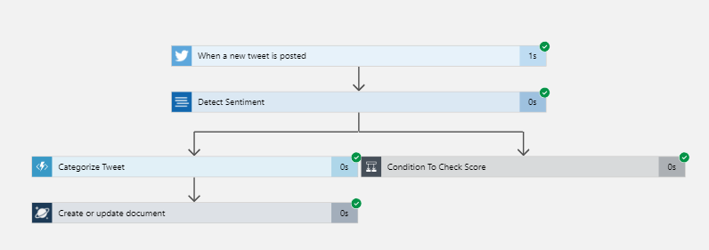
Introducing Azure Logic App
Powerful Integration. Hyperscale Workflow Engine, born in Azure
Faster integration using innovative Visual Designer.
Easy workflow creation with triggers and actions.
Mashup applications, data and services.
Built for mission critical Enterprise Integration.
Create, deploy, manage and monitor

Slide 15
Introducing Azure Logic App
Connect and Automate Common Task with Logic Apps
Use simple intuitive tools.
Create crucial reliable tasks without coding.
Integrate your mobile and web based apps.
Connect existing apps to SaaS services.

Slide 16

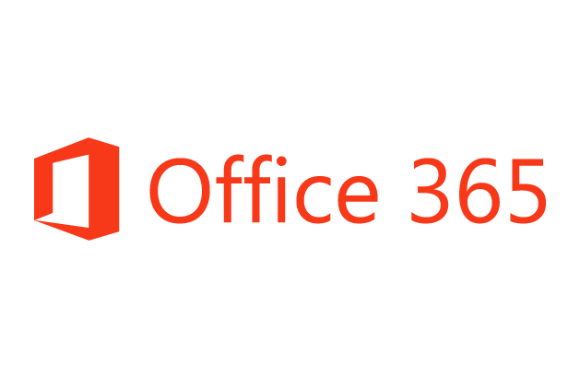













Machine Learning
Connect On-Premise Hybrid and Cloud Applications.
Run Mission Critical Complex Integration Scenarios with ease.
Build "Smart Integration" leveraging Machine Learning/ Cognitive Services.
B2B & EDI
Service Bus
Logic Apps
Cognitive Services
API Management
On-premises data gateway
BizTalk Server
Notes:
Logic Apps can integrate with “anything” (APIs) and solve small or complex problems. Automation in a secure and reliable environment fast and easy.
Connect Anything:
On-premises, hybrid and cloud
Mission critical, complex integration scenarios
Business productivity
Agile Business:
Quickly create workflows
Position to the future API centric
Transform Business:
Extract value from both (on-premises and cloud apps)
Build Holistic integration solutions.

Slide 17











Easy Hybrid Integration
On-premises Data Gateway
Azure API
Management
Azure Service Bus
Logic Apps
Logic Apps
Logic Apps
GatewayCloud Service
On-premises data gateway for rich data and application integration
Azure API Management for SOAP and backend APIs
Service Bus for cross platform support
APIM
Azure Service Bus relay
Virtual network or public
Queues
Topics
Gateway
Data Sources
LOB
Systems
SOAP web services
Backend
APIs
API-based

Slide 18
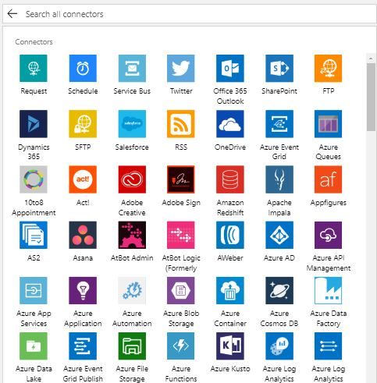
More Than 200 Connectors

Slide 19
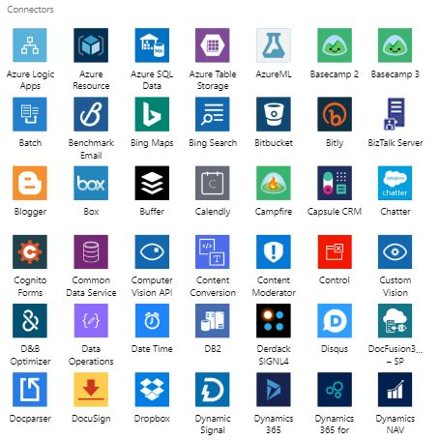

Slide 20
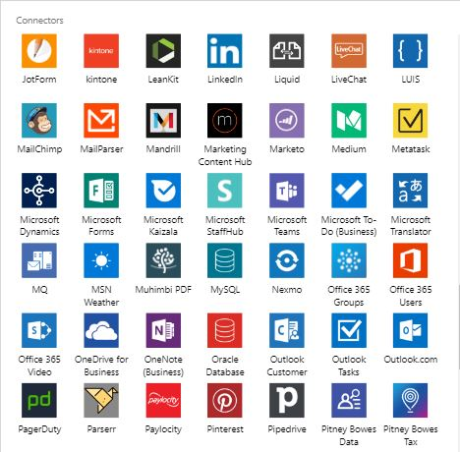

Slide 21

Connecting to APIs
OOB APIs Hosted by Logic Apps
Authenticate once and reuse.
Serviced by the product team.
First class designer experience
Auto Discovery of Azure Hosted APIS
Declarative reference an external APIs
Rapid development
Raw HTTP request for all other APIs

Slide 22
Logic App Designer
Add a Condition
Add a Scope
Add a Switch Case
Add a do Until
Add For Each

Slide 23
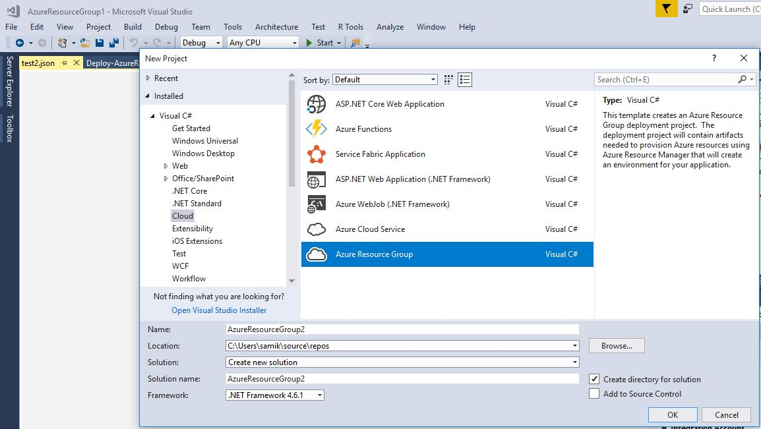
Development with Visual Studio

Slide 24
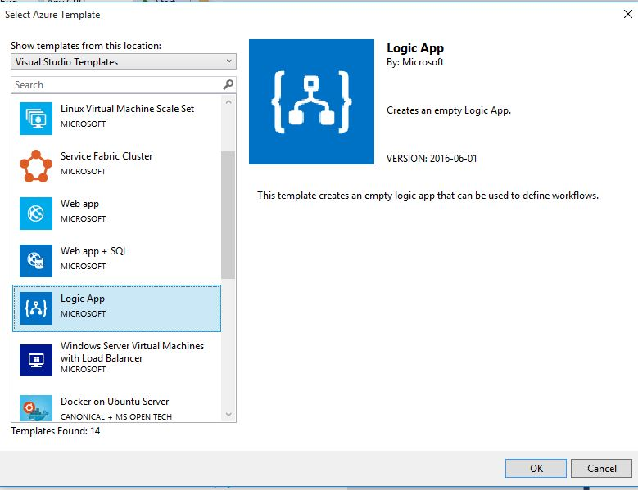
Integration with Visual Studio

Slide 25
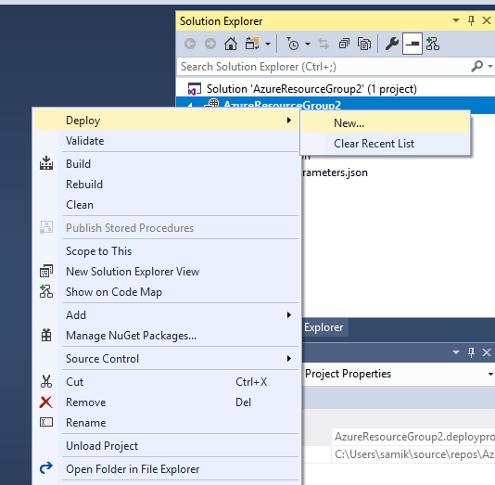
Development with Visual Studio

Slide 26
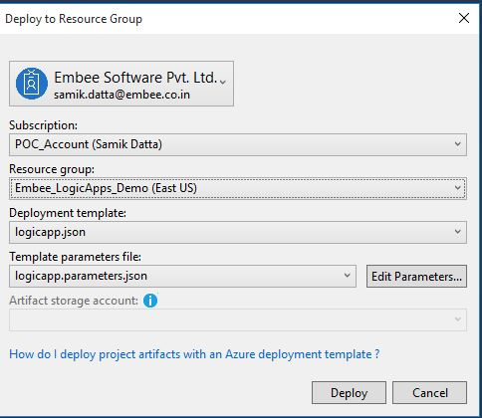
Development with Visual Studio

Slide 27
Some Learning
Background of the project.
Why migration was required.
What were the challenges faced?
Technologies used for the solution.
Performance tuning.
Best practices.
Migration of Existing Workflows using Logic Apps for an Enterprise Application

Slide 28
Demos

Slide 29
Call to action
Build some Logic Apps!
Logic Apps Documentation: http://aka.ms/logicapps-docs
Logic Apps Blog: http://aka.ms/logicappsblog
Logic Apps Monthly Webcast: http://aka.ms/logicappslive
Microsoft Integration on Channel 9: https://channel9.msdn.com/Blogs/Microsoft-Integration
Logic Apps Ideas: http://aka.ms/logicapps-wish
Re-visit Build session recordings on Channel 9.
Continue your education at Microsoft Virtual Academy online.

Slide 30
Thank You

